Slide 1

The Benefits of Acting

Slide 2

Benefits in children
Drama improves a child’s public speaking skill
Drama improves a child’s confidence
Acting makes a child more physically active

Slide 3
Steps to Becoming an Actor
Jump into theater in high school. The path to acting careers can actually begin in high school plays and musicals.
Get experience outside of school.
Get educated.
Practice makes perfect.
Build up an acting resume.

Slide 4
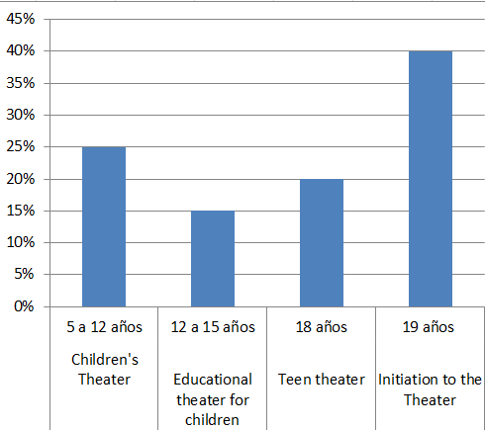
Start in the world of acting

Slide 5


